Slide 1

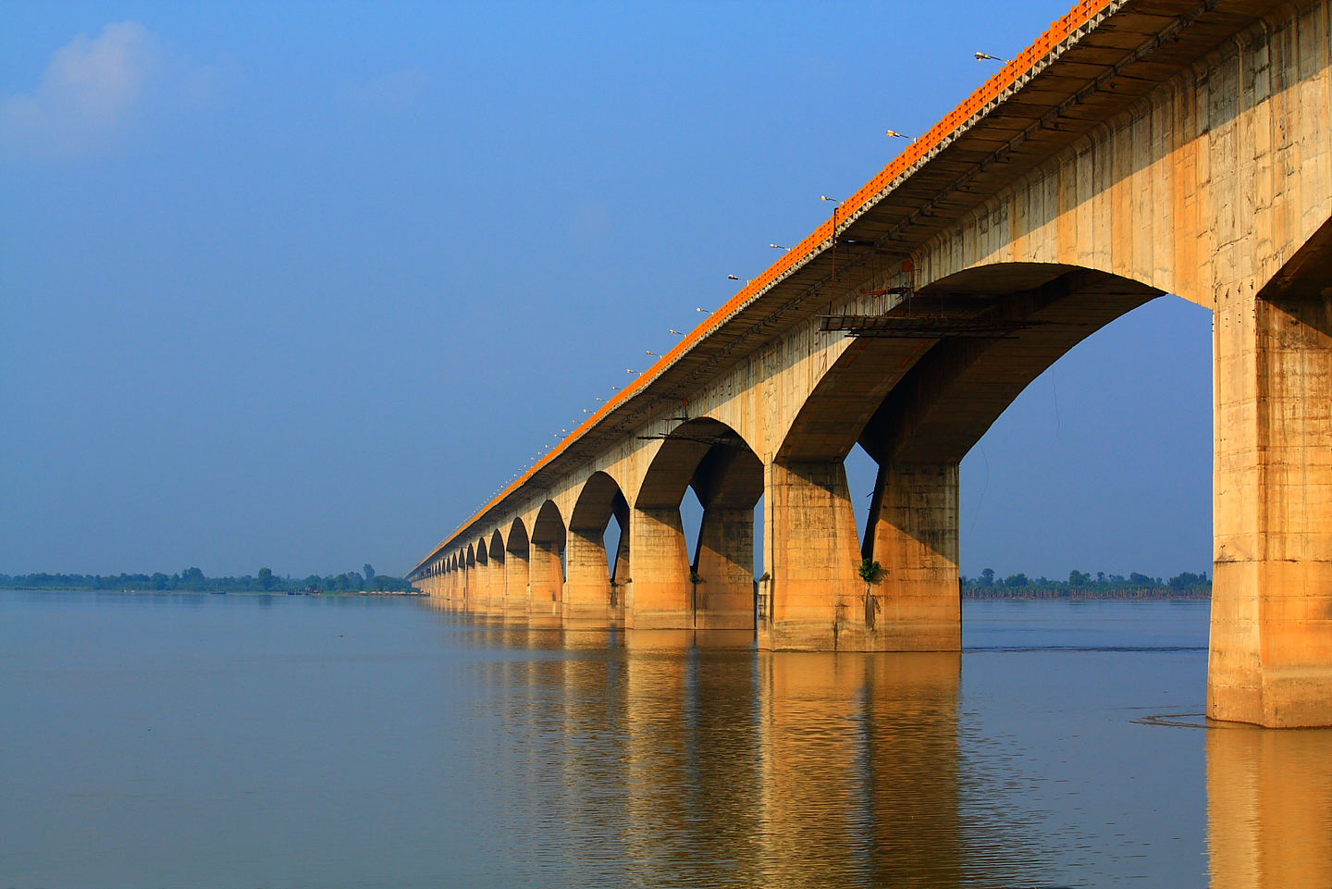
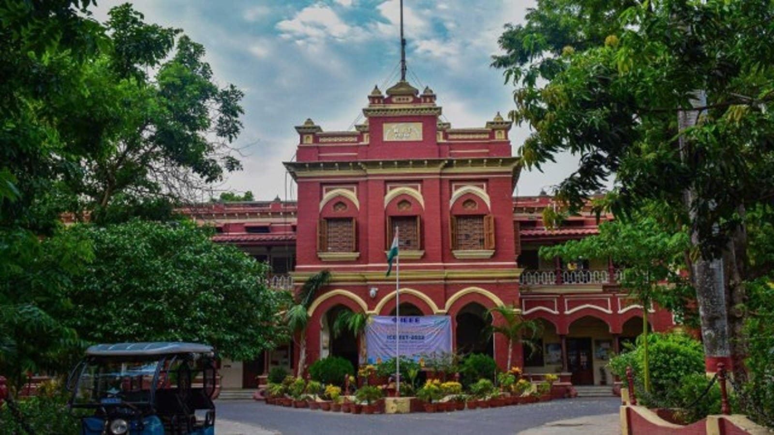
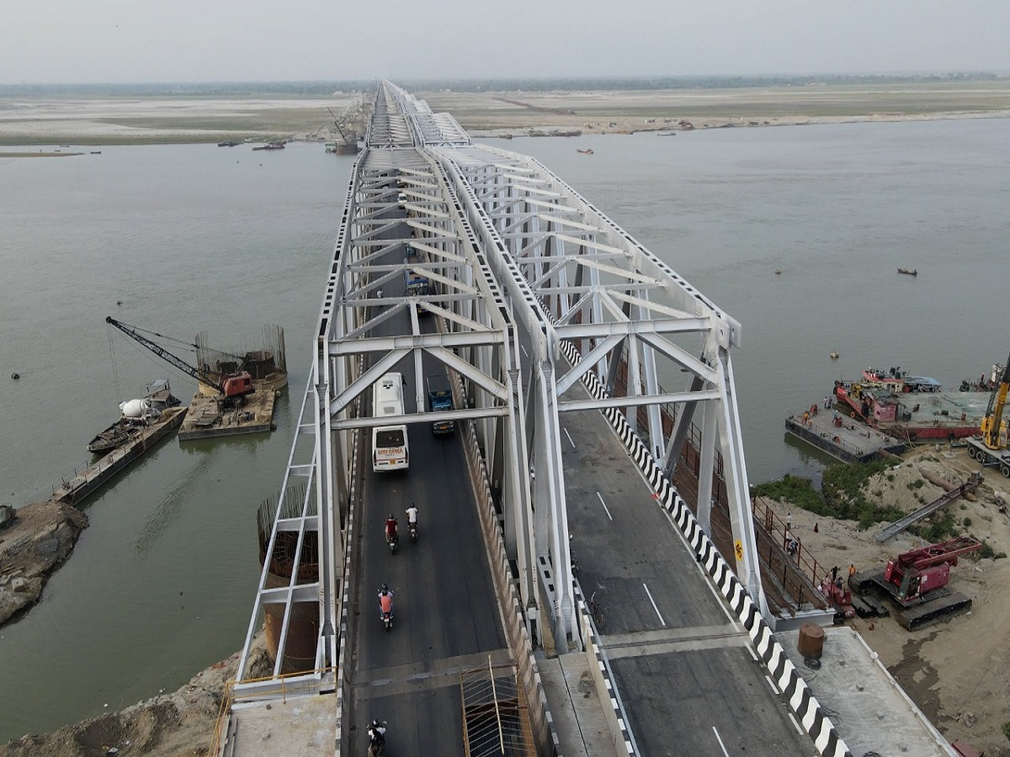










ISCESTI
2025
International Conference on Innovations and Sustainability in Civil Engineering
National Institute of Technology Patna
Title of the work
A. Author 1, B. Author 2, Z. Author n
Affiliation of the presenter (who is in indicated in bold)
NIT Patna 14-16 May 2025

Slide 2
ISCESTI
2025
International Conference on Innovations and Sustainability in Civil Engineering
National Institute of Technology Patna
NIT Patna 14-16 May 2025

